Slide 1
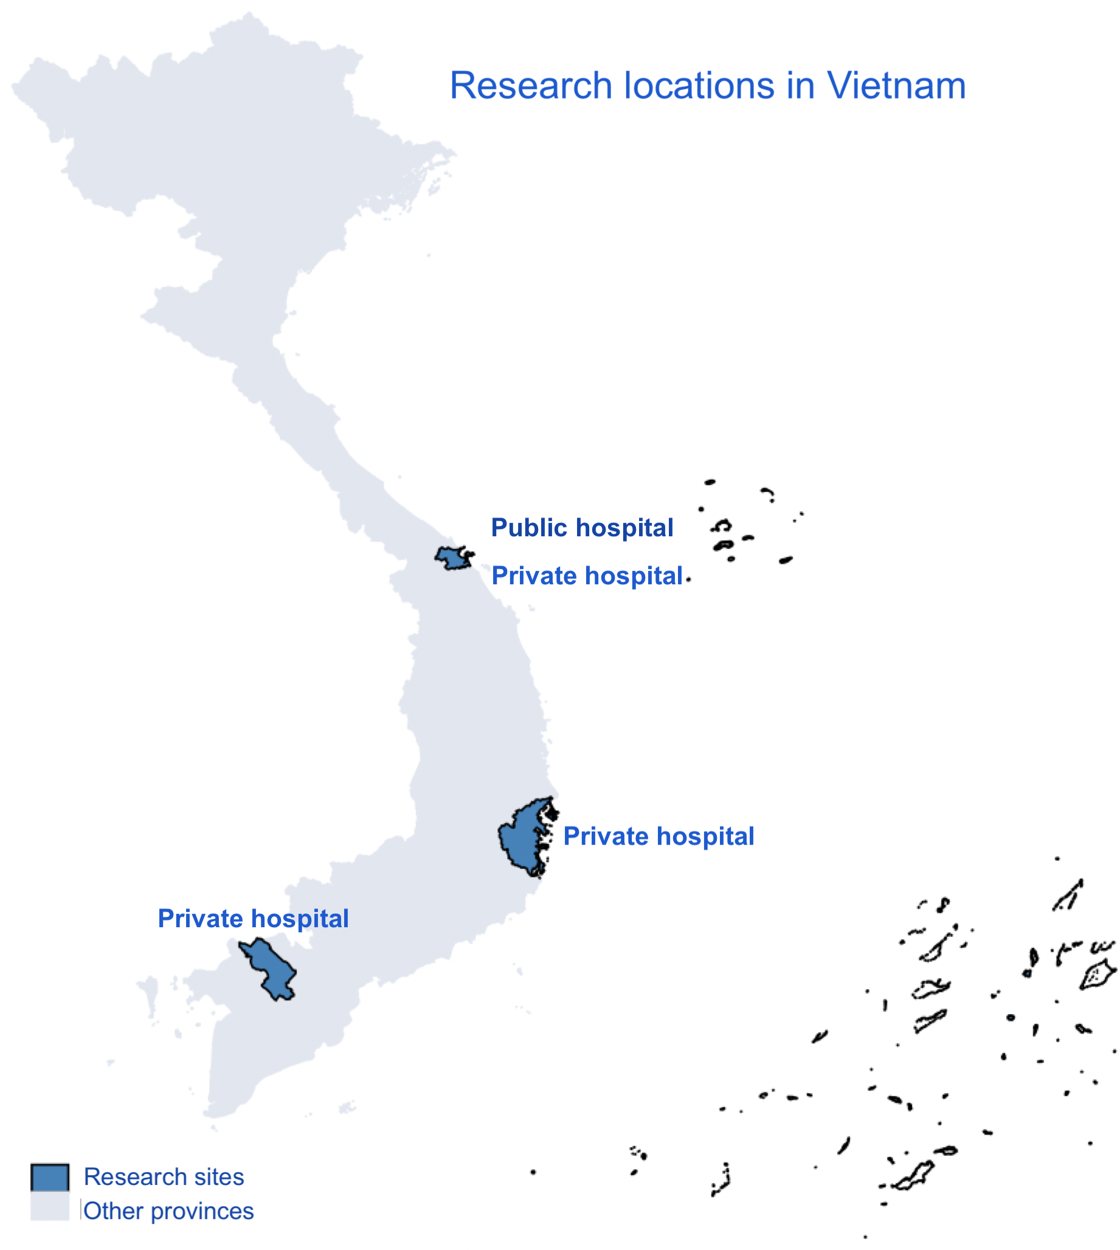
ANTIBIOTIC PRESCRIBING PRACTICES, INFECTION PREVENTION & CONTROL STRATEGIES AND
ANTIBIOTIC RESISTANCE AMONG NEONATAL SEPSIS IN VIETNAM: A MULTICENTRE STUDY
Nguyen Xuan Huong¹, Hoang Tran², Chau Le², Benjamin Dickson³, Michelle Harrison³, Nguyen Thi Kieu Trinh¹, Le Xuan Tuy¹ Phoebe CM Williams³
¹ Phan Chau Trinh University, Vietnam
² Da Nang Hospital for Women and Children, Vietnam
³ Faculty of Medicine, The University of Sydney, Australia
Background
Sepsis is a leading cause of morbidity and mortality in newborn babies (neonates). Antimicrobial resistance (AMR) is now further compounding this disease burden and is responsible for approximately one-third of neonatal deaths - largely due to the rapid global emergence of multidrug-resistant (MDR) gram-negative bacteria.¹ These pathogens are now a prominent cause of neonatal sepsis in resource-constrained settings, particularly in Southeast Asia.^{2,3} Despite this burden, there is a paucity of published granular data delineating the prevalence of pathogens responsible for neonatal sepsis (and their antibiotic resistance profiles) within many countries in Southeast Asia, including Vietnam.
The World Health Organization (WHO) currently recommends first-line treatment with ampicillin (or benzylpenicillin) plus gentamicin for neonatal sepsis; and second-line treatment with third-generation cephalosporins. However, recent observational studies have revealed high rates of non-susceptibility to the current empirical guidelines and high rates of empirical prescribing of WHO classified ‘Watch’ and ‘Reserve’ antibiotics, prompting calls to review current guidelines with define new regimens with improved efficacy against the contemporaneous causes of neonatal sepsis.^{1,4} Concurrently, strategies to reduce the risk of neonatal infections (such as Kangaroo Mother Care [KMC] ⁵ and enhancing breastfeeding rates) are urgently needed..
 | Public Hospital: Da Nang | Private Hospital: Da Nang | Private Hospital: Dong Thap | Private Hospital: Nha Trang | Total (N, or % where specified)
Neonatal beds* | 279 | 25 | 40 | 46 | 390
Deliveries each year | 10,159 | 492 | 1,308 | 1,339 | 13,298
Paediatricians/ Neonatologists | 14 | 1 | 0 | 4 | 19
Blood cultures analysed | 3,004 | n/a | n/a | 5 | 3,009
Routine pre-treatment blood cultures collected? | Yes | No | No | No | -
Positive blood cultures, contaminants excluded | 255 | n/a | n/a | 0 | 255
Gram-positive bacteria causative of neonatal sepsis | 65 | n/a | n/a | 0 | 65
Gram-negative bacteria causative of neonatal sepsis | 75 | n/a | n/a | 0 | 75
Bacterial isolates with antimicrobial susceptibility data available | 45 | n/a | n/a | 0 | 45
Fungal pathogens causative of neonatal sepsis (all Candida spp.) | 29 | n/a | n/a | 0 | 29
ESBL-producing Enterobacterales causative of neonatal sepsis | 9/25 (36%) | n/a | n/a | n/a | 36%
Carbapenem-resistant Enterobacterales causative of neonatal sepsis | 0/25 (0%) | n/a | n/a | n/a | 0%
Methicillin-resistant Staphylococcus aureus isolates, of those tested | 6/7 (86%) | n/a | n/a | n/a | 86%
Fluconazole-resistant Candida spp., of those tested | 0/8 (0%) | n/a | n/a | n/a | 0%
Empirical early-onset neonatal sepsis (EOS) antibiotic guidelines | Ampicillin and gentamicin | Ampicillin and gentamicin | Ampicillin and amikacin or Cefotaxime | Ampicillin and gentamicin | -
Empirical late-onset neonatal sepsis (LOS) antibiotic guidelines | Ticarcillin and amikacin | Cefotaxime and gentamicin | Ampicillin and cefotaxime | Ampicillin and gentamicin | -
Empirical neonatal meningitis antibiotic guidelines | Ampicillin, gentamicin and cefotaxime | Cefotaxime and gentamicin | Ampicillin, amikacin and cefotaxime | Cefotaxime | -
Routine use of prophylactic anti-fungal therapy for high-risk neonates? | No | No | No | No | -
Antibiotic point prevalence prescribing (PPS) survey: Proportion of Access antibiotics prescribed | 81% | 86% | 60% | 100% | -
Antibiotic point prevalence prescribing (PPS) survey: Proportion of Watch antibiotics prescribed | 19% | 14% | 40% | 0% | -
Antibiotic point prevalence prescribing (PPS) survey: Proportion of Reserve antibiotics prescribed | 0% | 0% | 0% | 0% | -
Kangaroo Mother Care (KMC) practiced ≥50% of each 24h period | Yes | Yes | No | Yes | -
Lactation support staff available | Yes | Yes | Yes | Yes | -
Human Donor Milk Program available | Yes | No | No | Yes | -
≥75% exclusive breastfeeding at discharge | Yes | Yes | No | Yes | -
≥75% exclusive breastfeeding at 6-week postnatal check | Yes | Yes | No | Yes | -
Aims
As part of the Neonatal Sepsis in Southeast Asia and the Pacific (NeoSEAP) study, we aimed to evaluate the contemporaneous causes of neonatal sepsis in Vietnam across both public and private hospital settings, and compare these to other sites across Southeast Asia. Concurrently, antibiotic prescribing practices and infection, prevention and control (IPC) resources were analysed to consider their relation to the local epidemiology of multidrug-resistant (MDR) neonatal infections.
Methods
A two-year multicentre retrospective review of positive blood cultures across four hospitals in Vietnam was undertaken, to evaluate the epidemiology of neonatal sepsis and the prevalence of MDR infections.
Concurrently, a point prevalence antibiotic prescribing survey and a standardised IPC and resource availability survey were conducted. Findings were compared between public and private sectors and other NeoSEAP sites in Southeast Asia.
Results
Across four public and private hospitals in Vietnam incorporating 13,298 neonatal deliveries each year, 3,009 blood cultures were collected including 273 positive cultures, of which 225 revealed significant bacterial and fungal pathogens (Table 1).
Serratia spp., Klebsiella spp., and Candida spp. were the most common pathogens isolated as causative of neonatal sepsis. Among gram-negative Enterobacterales, there were high rates of third-generation cephalosporin resistance (36%), yet carbapenems remained universally susceptible.
Routine collection of blood cultures prior to commencing empiric antibiotics for clinical suspicion of neonatal sepsis was not practiced at two private hospitals, and was limited by microbiological resource availability (as was availability of susceptibility testing) in a major urban tertiary public hospital.
Judicious antibiotic prescribing was evident, with over 80% of empirical antibiotics prescribed WHO ‘Access’ classified, and no ‘Reserve’ antibiotics were prescribed.
There were high rates of protective practices observed, with Kangaroo Mother Care (KMC) practiced intensively for infants of all gestational ages, and high rates of breastfeeding achieved both at hospital discharge and at postnatal follow-up (Table 1).
Table 1: Pathogens and antimicrobial susceptibility profiles of bacteria and fungi responsible for neonatal sepsis, alongside empiric prescribing practices and IPC and antibiotic point prevalence survey results across four hospitals in Vietnam.
*Neonatal beds includes special–care nursery, HDU, ICU
^Contaminants excluded: coagulase-negative Staphylococci, Corynebacterium spp., Bacillus spp.
Conclusion:
Constrained microbiology resource availability significantly impacts the attainment of blood cultures prior to commencing antibiotics for neonates with clinical sepsis in both private and public hospitals in Vietnam. Of the small number of culture-positive sepsis cases confirmed, our study revealed lower rates of gram-negative resistance in neonatal sepsis in Vietnam compared to other Southeast Asia settings,⁶ alongside more judicious antibiotic prescribing (in accordance with WHO Adopt Aware guidance). Comparatively high rates of Candidaemia suggest a need for locally-tailored antifungal prophylaxis protocols.
The lower prevalence of MDR gram-negative bacteria causing neonatal sepsis in Vietnam compared to other sites in Southeast Asia likely reflects judicious local antibiotic stewardship programs, alongside high rates of KMC and strong breastfeeding practices within Vietnam.
References
Williams, PCM, Qazi S, Shamin A, Agarwal R, et al. Antibiotics needed to treat multidrug-resistant infections in neonates. Bull WHO 2022; 100(12)
Laxminarayan R, Bhutta ZA. Antimicrobial resistance&#x2014;a threat to neonate survival. Lancet Glob Heal 2017; 4: e676–7.
Murray et al. Global burden of bacterial antimicrobial resistance in 2019. Lancet 2022, 399 (10325), p629-655.
Russell N et al. Patterns of antibiotic use, pathogens and predition of mortality in hospitalised neonates and young infants with sepsis: the NeoOBS study. PLOS Medicine; 2022, e1004179.
Arya S. et al. Effect on neonatal sepsis following immediate KMC in a NICU: a post-hoc analysis of a multi-centre, open-label, randomised controlled trial. Lancet eClinical Med; 2023, 60(102006).
Williams PCM et al. Coverage gaps in empiric antibiotic regimens used to treat serious bacterial infections in children in Southeast Asia and the Pacific. Lancet Regional Health; 2023, doi:.org/10.1016.lansea2023.100291.

