Slide 1
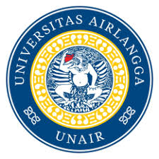
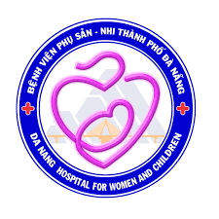
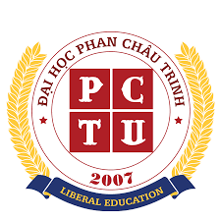
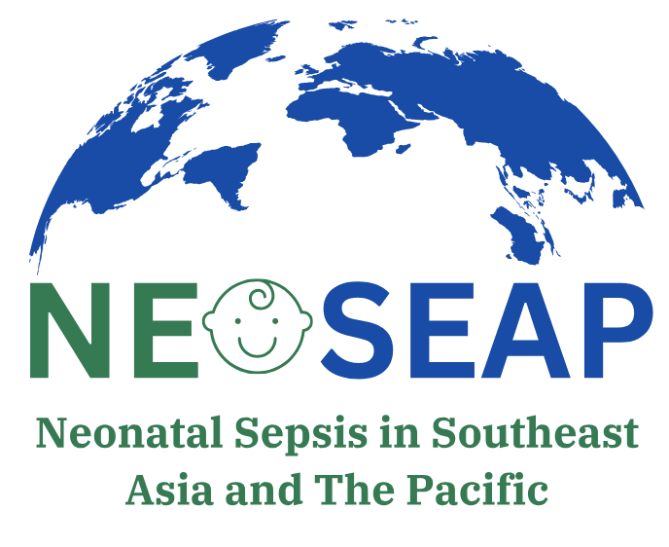
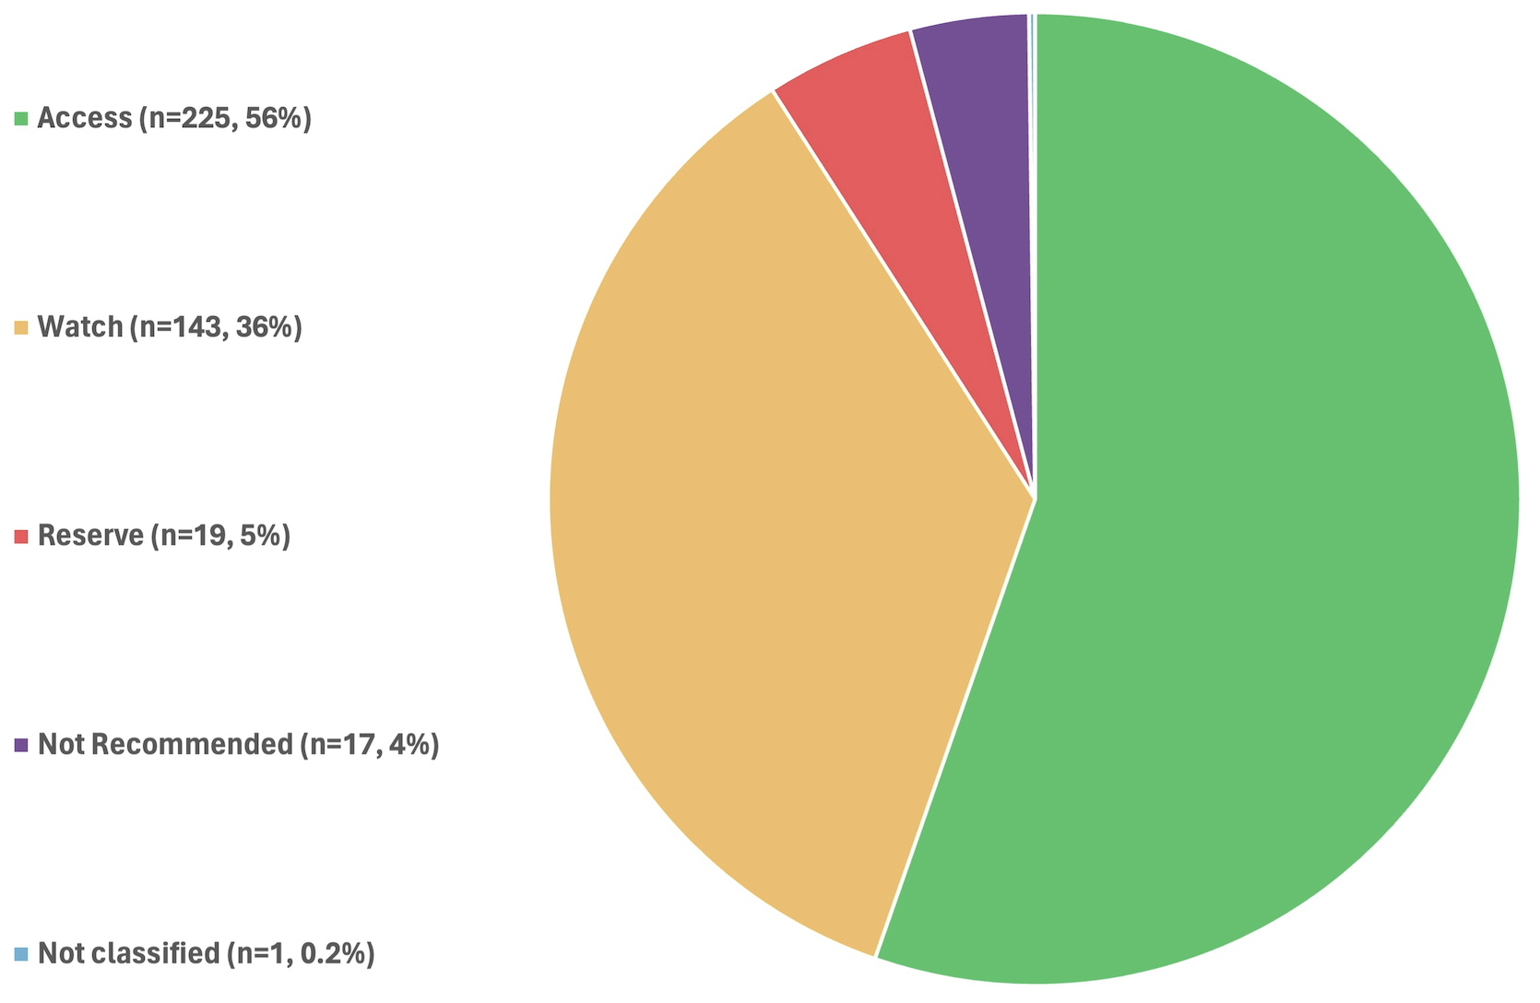
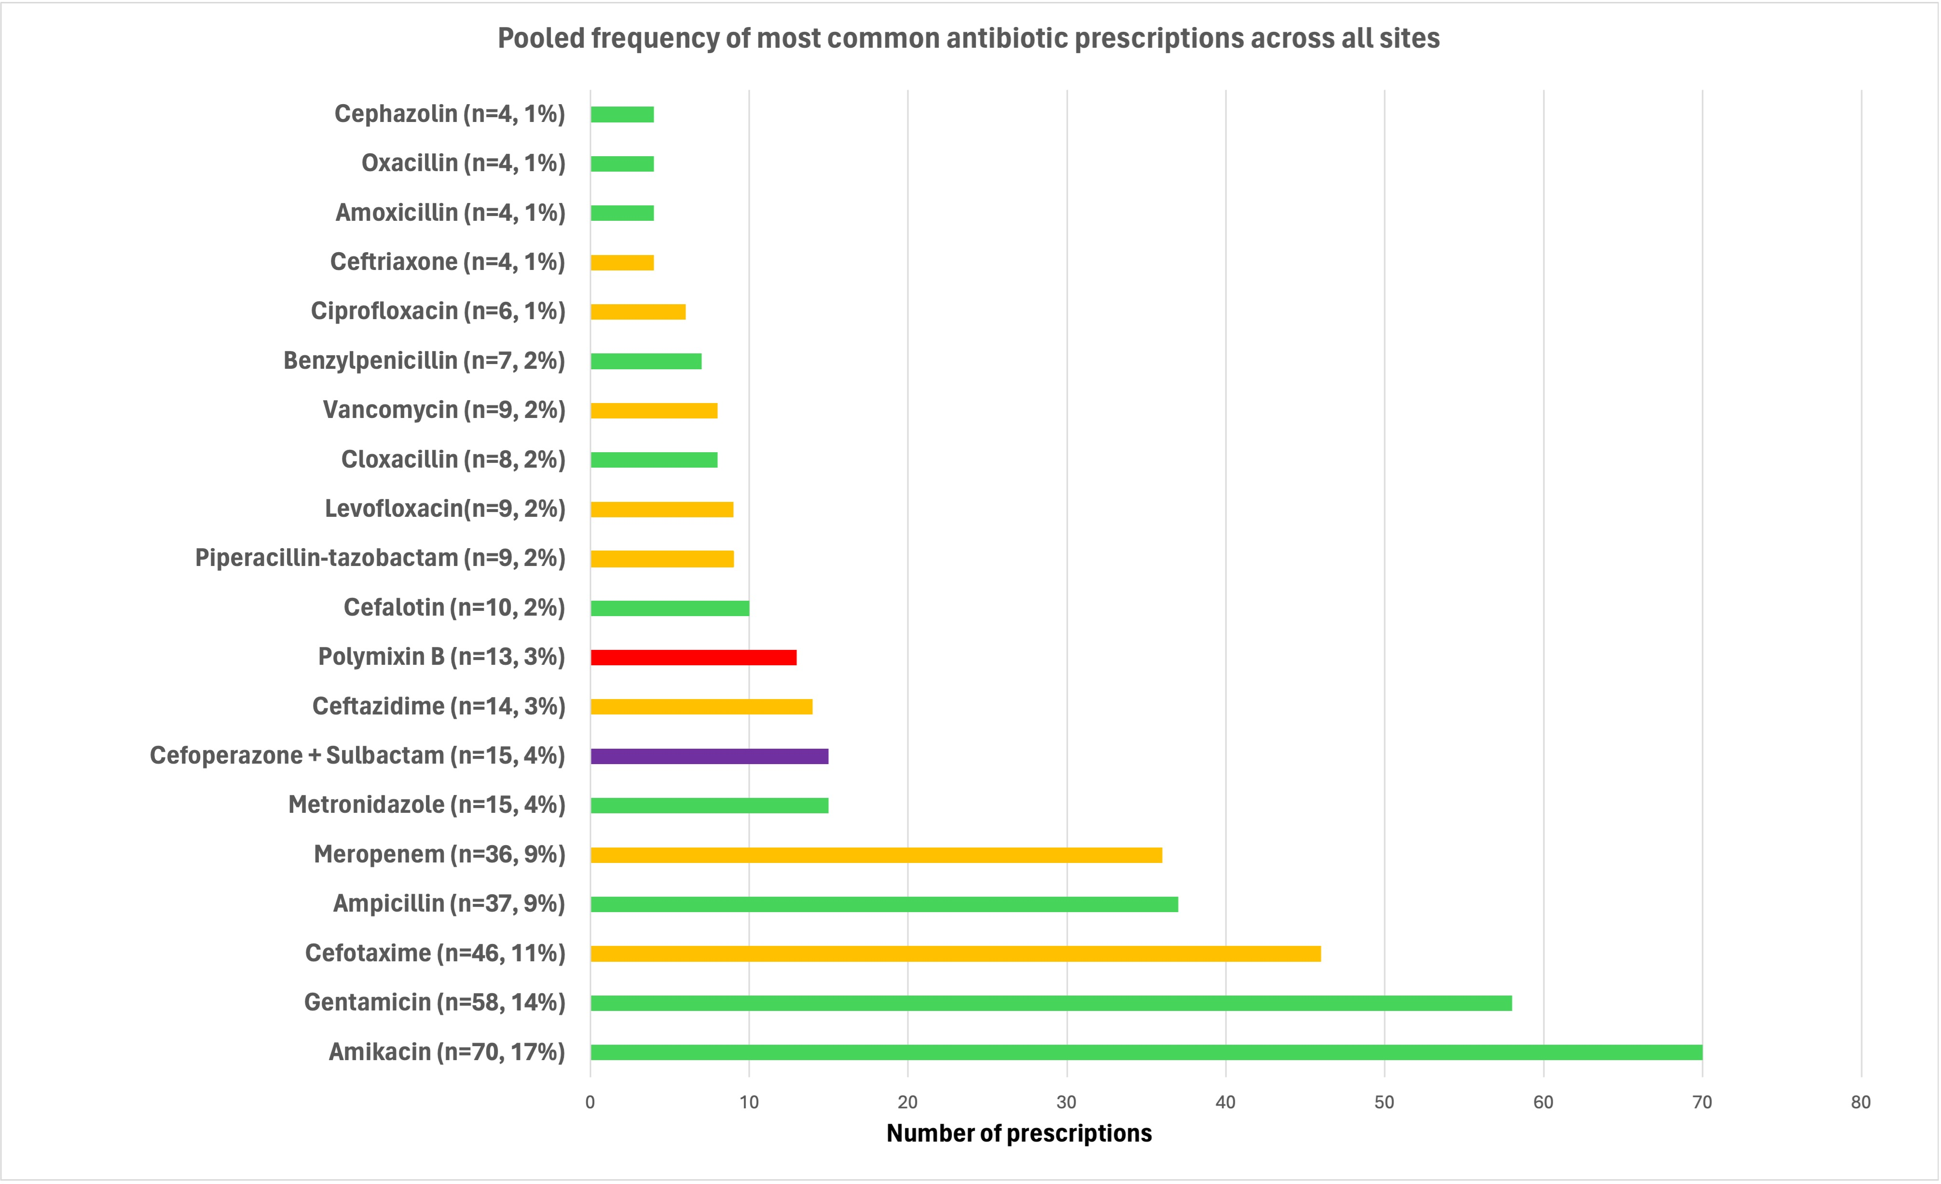
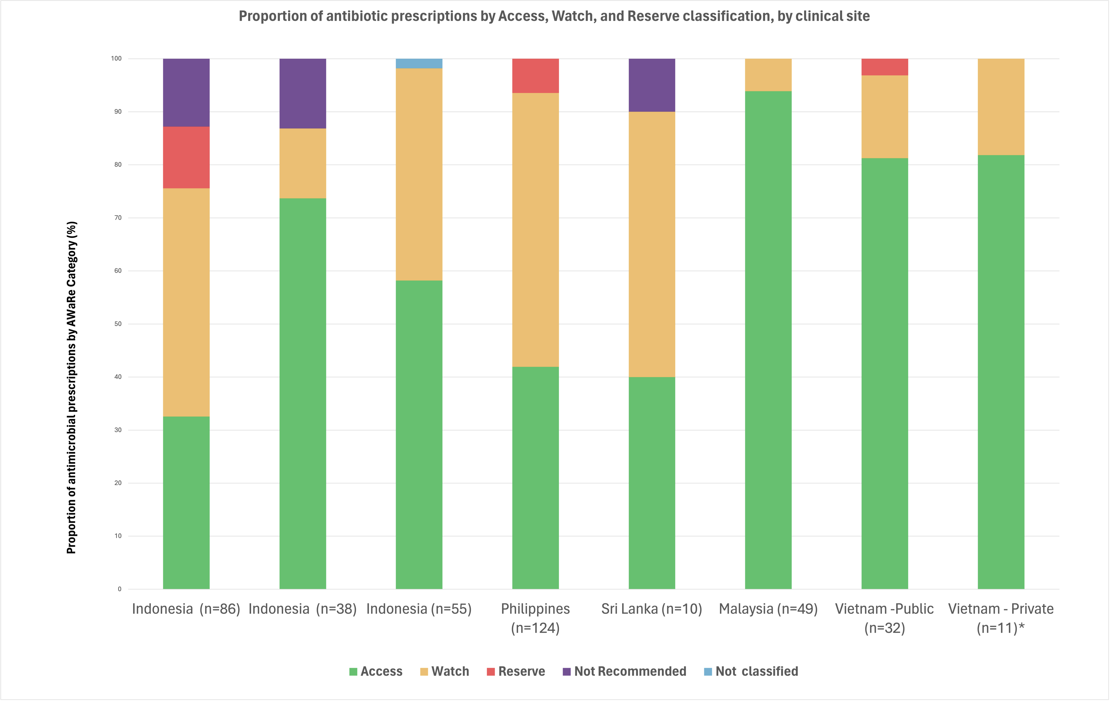
GAD05-05
High rates of watch and reserve antibiotic prescribing in the treatment of neonatal infections among resource-constrained settings in Southeast Asia
Benjamin F.R. Dickson¹, M. Harrison ¹, M.E. Villanueva-Uy ², N. Putri ³, R. Adrizain ⁴, L. Kartina ⁵, G. Gunaratna ⁶, C. Le ⁷, H. Tran ⁷, N. Huong ⁸, S. M. Fong ⁹ , Phoebe CM Williams ¹ ¹The University of Sydney - Sydney (Australia), ²Institute of Child Health and Human Development, National Institutes of Health - Manila (Philippines), ³Universitas Indonesia - Jakarta (Indonesia), ⁴University of Padjaran - Bandung (Indonesia), ⁵University of Airlangga - Surabaya (Indonesia), ⁶Faculty of Medicine, University of Kelaniya - Colombo (Sri Lanka),
⁷Da Nang Hospital for Women and Children - Da Nang (Vietnam), ⁸Pham Chau Trinh University - Da Nang (Vietnam), ⁹Sabah Women’s and Children’s Hospital, Sabah (Malaysia)
BACKGROUND
The rise of antimicrobial resistance (AMR) poses a major challenge to global health.¹
Neonates are highly vulnerable to this threat (214,000 AMR-attributable deaths/year).²
Understanding antimicrobial prescribing patterns is crucial to address the rising burden of AMR globally.
There remains sparse data on antibiotic usage in resource-constrained healthcare settings, where the burden of AMR is the greatest and access to newer agents is limited.³
METHODS
Figure 1: Location of participating point prevalence survey sites
We conducted a comprehensive prospective antibiotic Point Prevalence Survey (PPS) as part of the NeoSEAP project (Neonatal Sepsis in Southeast Asia and the Pacific).
10 clinical sites across Indonesia, Vietnam, The Philippines, Sri Lanka & Malaysia participated in the PPS, undertaken on one day between December 2022-December 2023 (Figure 1).
Inclusion criteria: All admitted Infants ≤ 180 days old.
RESULTS
667 hospitalised infants were included in the study, who were prescribed a total of 405 antibiotics (Figures 2-4).
42 different antibiotics were prescribed across the ten clinical sites.
218 infants (33%, 218/667) were prescribed ≥1 antibiotic.
85% of infants (191/218) had blood cultures collected, but only 19% (42/218) were prescribed antibiotics targeted to a causative bacteria.
Klebsiella pneumoniae (n=23) and Acinetobacter spp. (n=11) were the most frequently isolated bacteria on blood culture.
Figure 2. Proportion of antimicrobials prescribed (by WHO AWaRe Category) across ten clinical sites in South and Southeast Asia
Figure 4. Pooled frequency of the most common antibiotics prescribed
across all 10 clinical sites in South and Southeast Asia
*Frequencies of <1% of the total prescriptions have been omitted from this figure.
Colors depict WHO Access, Watch, Reserve classification for each antibiotic (see Figure 2 legend)
CONCLUSION
WHO categorized ‘Watch’, ‘Reserve’ and ‘Not recommended’ antibiotics are commonly prescribed to treat hospitalized neonates in South and Southeast Asia.
Empirical antibiotics frequently include broad-spectrum agents in these settings, as infections are rarely confirmed with positive cultures.
Where (blood or cerebrospinal fluid) cultures are positive, multidrug-resistant gram-negative infections are common, driving the use of broad-spectrum empiric therapy and further propagating antimicrobial selection pressure in clinical settings.
There is an urgent need for improved diagnostics and treatment options to improve the management of neonatal sepsis globally.
Figure 3. Proportion of antimicrobial prescriptions by Access, Watch & Reserve classification by clinical site
*Three private hospital sites in Vietnam are represented together
References:
Laxminarayan R et al. Access to effective antimicrobials: a worldwide challenge. Lancet. 2016.
Antimicrobial resistance collaborators. Global burden of bacterial antimicrobial resistance in 2019: A systematic analysis.
Williams PCM., et al. Antibiotics needed to treat multidrug-resistant infections in neonates. Bulletin of the World Health Organization. 2022
.

